Slide 1
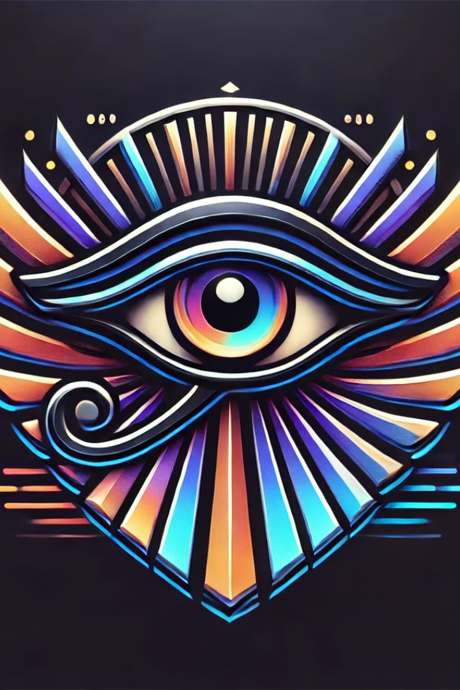
VISION
"From Detection to Perception – Redefining Accessibility"
Mentor: Anjali Chauhan
Pratibha
Kanika Sangal
Vanshika Tyagi
Nandini Gupta

Slide 2

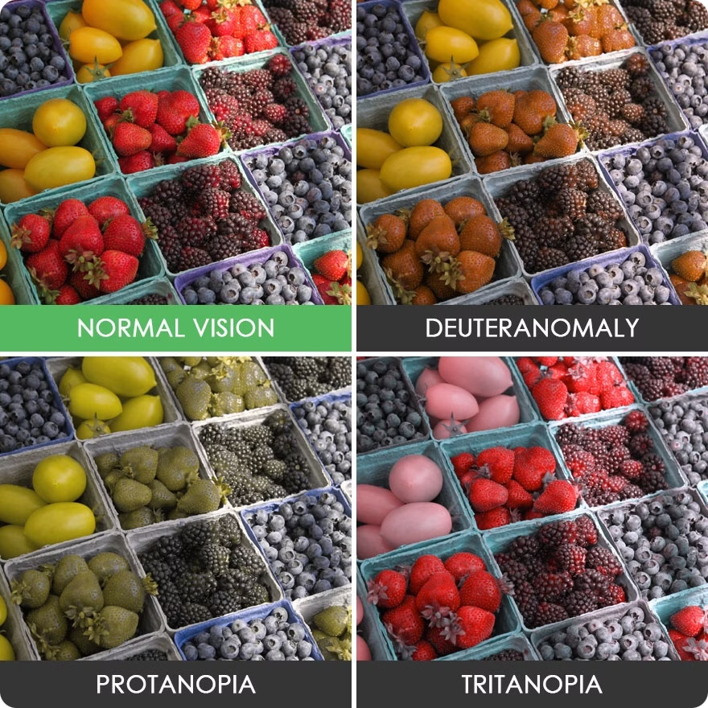
Problem Statement
Color vision deficiencies and cataracts affect vision and quality of life. Traditional diagnostic methods are time-consuming, subjective, and inconsistent, highlighting the need for more efficient and accurate solutions.
Limited Accessibility
Subjectivity of Testing
Specialized diagnostic equipment and qualified professionals are not readily available in many regions, hindering timely diagnosis and treatment.
Traditional color vision tests rely on human judgment and are prone to inconsistencies and errors, impacting the accuracy of diagnoses.
Time-consuming Processes
Diagnostic procedures can be lengthy and require multiple visits, potentially delaying treatment and impacting patient care.

Slide 3

Solution Overview
Vision algorithms can analyze retinal images to automatically detect and classify color vision deficiencies and cataracts, offering several advantages over traditional methods.
1
Improved Accuracy
2
Automated Processing
Vision algorithms analyze vast amounts of data with high precision, leading to more accurate diagnoses compared to human judgment.
Automation streamlines the diagnostic process, reducing time and manual effort, enabling faster diagnoses and treatment initiation.
3
Enhanced Accessibility
4
Cost-Effectiveness
Computer vision solutions can be deployed on mobile devices and remote locations, improving access to diagnosis and treatment for underserved populations.
Automated diagnosis reduces the need for expensive equipment and specialized personnel, making healthcare more affordable and accessible.

Slide 4
Methodology
We developed and implemented a comprehensive methodology , techniques and machine learning algorithms to analyze retinal images.
Data Acquisition
1
Collecting a large and diverse dataset of retinal images from individuals with and without color vision deficiencies and cataracts.
2
Image Preprocessing
Preparing the images for analysis by removing noise and artifacts, enhancing features, and standardizing image dimensions.
Feature Extraction
3
Extracting meaningful features from the images using deep learning models, capturing patterns and characteristics associated with specific eye conditions.
4
Model Training
Training machine learning models to classify the extracted features, differentiating between healthy eyes and those with color vision deficiencies and cataracts.
Model Evaluation
5
Evaluating the trained models' performance on independent datasets to ensure accuracy, reliability, and generalizability.

Slide 5

Color Vision Deficiencies
Color vision deficiencies, also known as color blindness, affect an individual's ability to perceive certain colors correctly.
Type
Description
Protanopia
Red deficiency
Deuteranopia
Green deficiency
Tritanopia
Blue deficiency

Slide 6
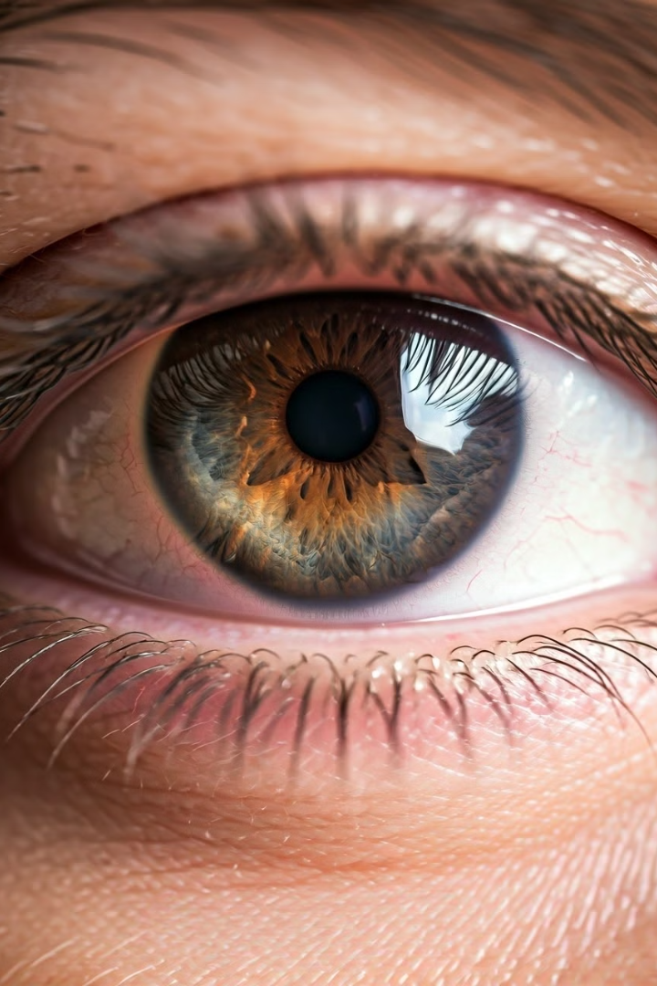



Cataract Detection
Cataracts are a clouding of the natural lens of the eye, affecting vision clarity and causing blurred vision.
Symptoms
Blurred vision, double vision, halos around lights, difficulty seeing at night, faded colors.
Causes
Aging, diabetes, smoking, exposure to ultraviolet radiation, certain medications.
Treatment
Surgical removal of the cloudy lens and replacement with an artificial lens.

Slide 7
Daltonization: Enhancing Color Vision for the Colorblind
The Daltonization algorithm is a transformative tool designed to enhance visual perception for individuals with color vision deficiencies (CVD), commonly known as color blindness. By adjusting and modifying color representations, it enables colorblind individuals to better differentiate colors that would otherwise appear indistinguishable.
It is a computational process that alters images or visual content to compensate for the color perception deficiencies caused by color blindness. The algorithm works by shifting problematic color ranges and enhancing contrast between colors that would typically be confused by someone with CVD.

Slide 8
How Daltonization Works?
1
Color Space Transformation
2
Simulating Color Vision Deficiency
The image is first converted from the typical RGB (Red, Green, Blue) color space into a perceptual color space, such as LMS, which models how the human eye perceives colors.
The algorithm then simulates how a person with color blindness sees the image. This simulation identifies the specific colors that are problematic for individuals with different types of CVD (protanopia, deuteranopia, or tritanopia).
3
Color Adjustment
4
Inverse Transformation
Based on the simulation, the algorithm modifies the problematic colors, shifting them to more distinguishable hues while preserving the overall balance and natural appearance of the image.
Finally, the modified image is converted back to the standard RGB color space, allowing the colorblind individual to perceive the enhanced version of the image.

Slide 9
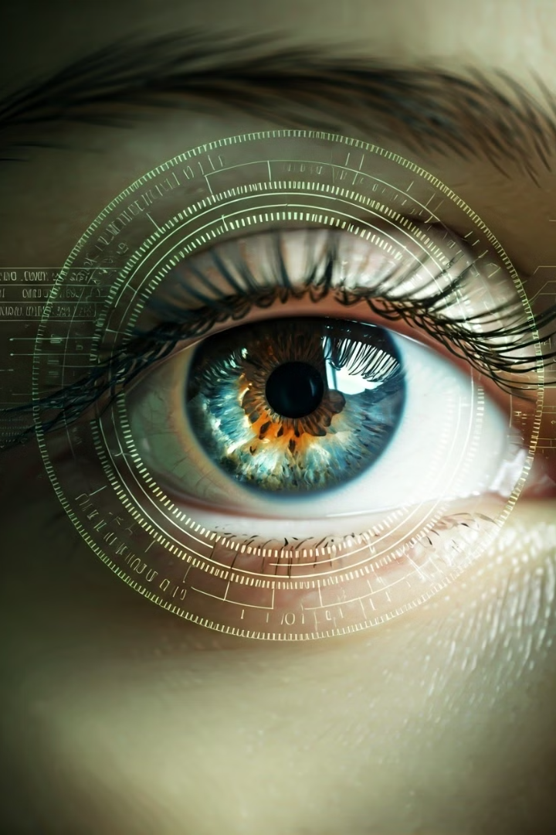



Conclusion
Computer vision has emerged as a powerful tool in healthcare, revolutionizing the detection and diagnosis of eye conditions.
Enhanced Accuracy
Computer vision algorithms provide highly accurate and objective diagnoses, improving the reliability of patient care.
Improved Efficiency
Automation streamlines diagnostic processes, reducing time and effort, allowing for faster diagnoses and treatment initiation.
Increased Accessibility
Computer vision solutions can be deployed in various settings, increasing access to diagnosis and treatment for diverse populations.

